Slide 1
South Africa
Overview of Oral Pre-Exposure Prophylaxis (PrEP)
November 2022

Slide 2
South Africa
Introduction and Phased Implementation of Oral PrEP
(June 2016 – September 2022)
Since programme inception in June 2016 to September 2022 , over 726 745 individuals were initiated on oral PrEP
2016
2017
2018
2019
2020
2021
2022
Sex Workers
Sex Workers
MSM
Universities
Sex Workers
MSM
Universities
AGYW
Sex Workers
MSM
Universities
AGYW
TG
PWID
Scale-up to Public Facilities
Covid-19 Pandemic
13
Sites
771
PrEP initiations
21
Sites
3 196
PrEP initiations
74
Sites
8 593
PrEP initiations
120
Sites
45 576
PrEP initiations
1 421
Sites
98 586
PrEP initiations
2 702
Sites
288 237
PrEP initiations
3 162
Sites*
281 786
PrEP initiations*
Source:Consolidated from DHIS, TIER and implementing partner reports.

Slide 3
South Africa Provincial Distribution of Oral PrEP Initiations (June 2016 – September 2022)
726 745
Individuals Initiated on oral PrEP
3 162
Facilities
Limpopo
169 649
24 405
Gauteng
Mpumalanga
North West
110 586
15 344
Free State
41 861
KwaZulu-Natal
Northern Cape
242 352
566
Eastern Cape
83 274
Western Cape
38 708
Source:
Consolidated from DHIS, TIER and implementing partner reports.

Slide 4
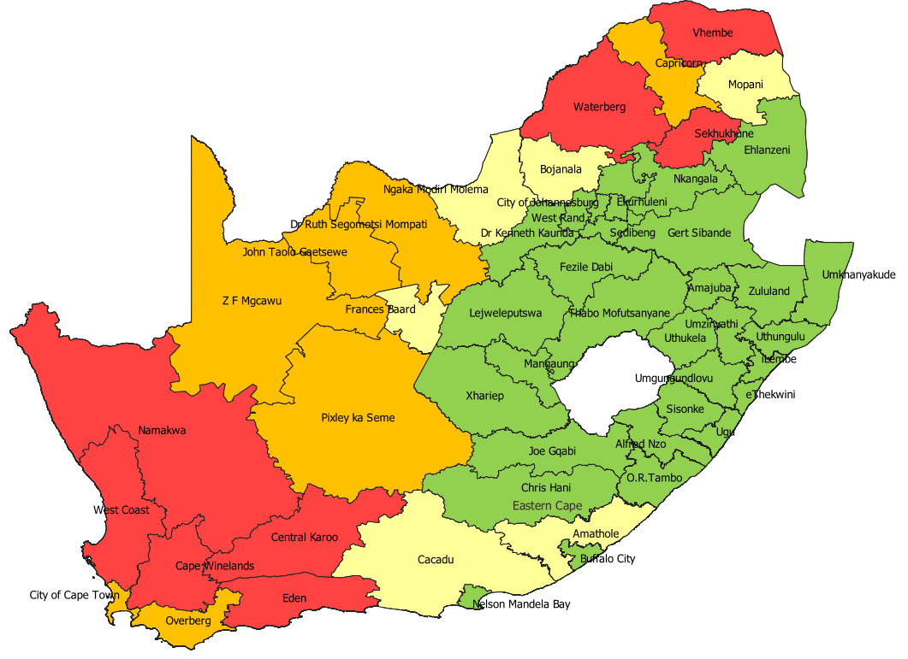
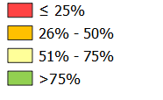
Map of Provincial & District Public PHC Facility Coverage Oral PrEP
(June 2016 – September 2022)
South Africa : 74% public PHC facility coverage has been reported from June 2016 to September 2022.
Public PHC facility Coverage June 2016 to September 2022
EC | 621 | 81%
FS | 217 | 96%
GP | 361 | 98%
KZN | 613 | 98%
LP | 125 | 26%
MP | 285 | 98%
NC | 53 | 33%
NW | 197 | 64%
WC | 74 | 33%
SA | 2 549 | 74%
Public PHC Facility coverage
Source:
Consolidated from DHIS, TIER and implementing partner reports..

Slide 5
South Africa Demographic uptake of oral PrEP
Phased Implementation
South Africa oral PrEP initiations by gender and age
(based on 580 585 initiations between April 2020 – September 2022, for which demographic details are available)
180
172 738
190 049
Oral PrEP initiations (x10³⁾
160
140
120
136 357
100
80
60
61 176
40
20
7 944
12 321
0
<15 years
15-19 years
20-24 years
25-34 years
35-49 years
50 years +
Male
Female
Source: consolidated from TIER and Partner reports (April 2020 – September 2022).

