Slide 1
Optimizing HIV treatment
Professor Francois Venter
Ezintsha, University of the Witwatersrand, Johannesburg, South Africa
Thanks to: The Ezintsha team, HE²RO, Sydney Rosen, Anna Grismrud, Phumla Sinxabi, Andrew Hill, Gary Maartens, Mohammed Ali, Mark Siedner, Elvin Geng, Aaloke Mody, Jeff Wing, Vince Marconi, Yogan Pillay, Liesel Page-Shipp, Thato Chidarikire

Slide 2


Disclosures: Francois Venter
Research Support: USAID; Unitaid; South African Medical Research Council; Bill and Melinda Gates Foundation; study drug donations from ViiV Healthcare, Merck and Gilead Sciences; study support Merck,ViiV, J&J
Speaker’s Bureau/Board Member/Advisory Panel: Gilead, ViiV, Mylan, Merck, Adcock-Ingram, Aspen, Abbott, Roche, J&J, Sanofi and Virology Education. Southern African HIV Clinicians Society
Notes:
I have received research support, speaker and advisory board fees as well as conference support from various organisations

Slide 3
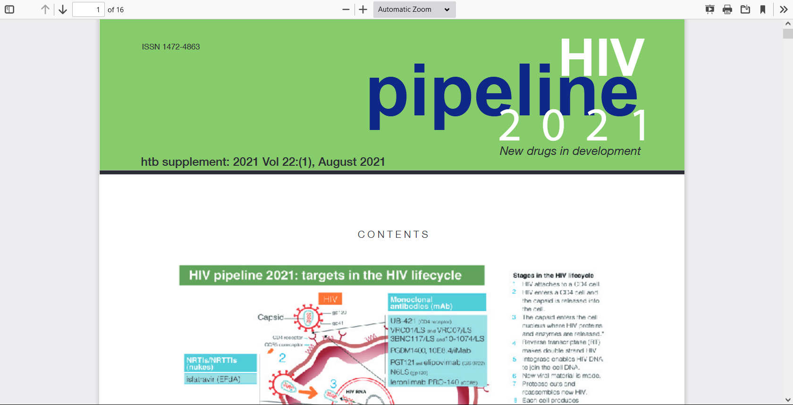
Shout out… https://i-base.info/

Slide 4
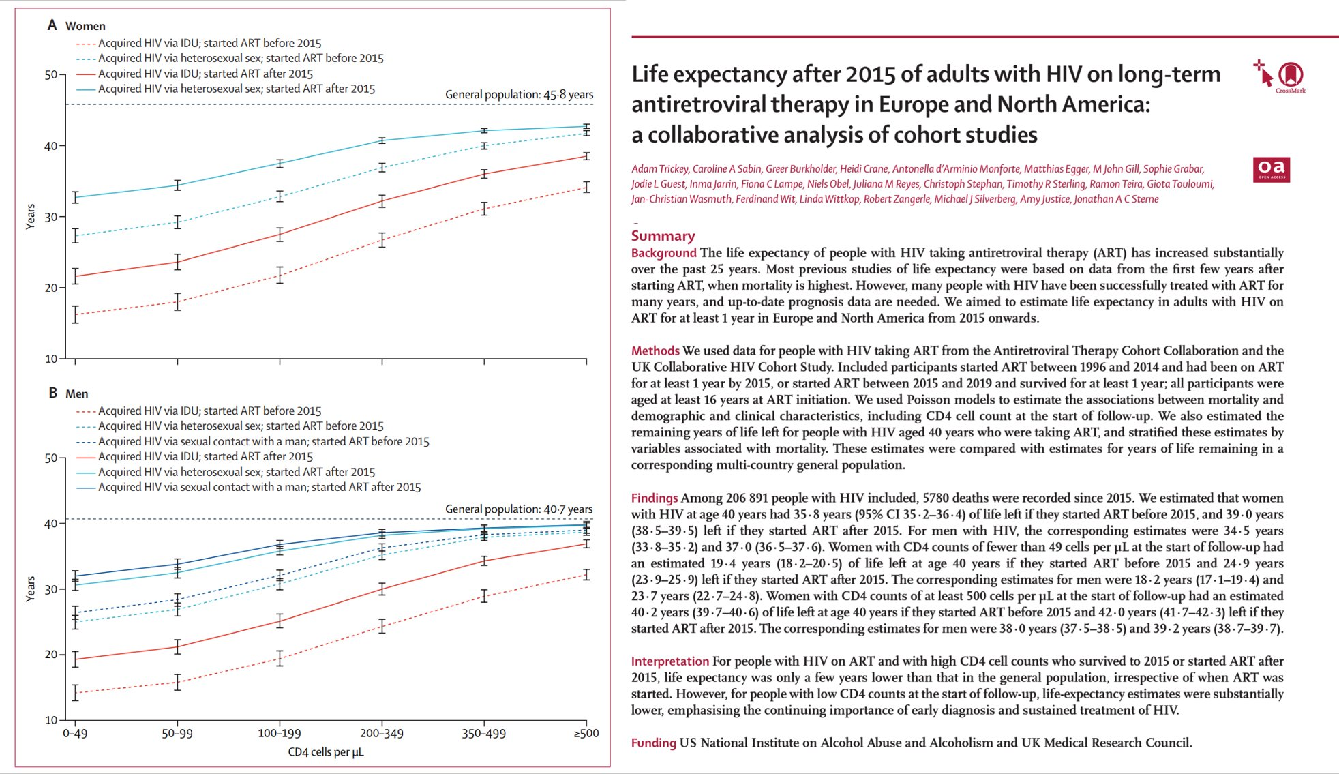

HIV treatment is VERY effective, if given early
“…life expectancy was only a few years lower than that in the general population …. However, for people with low CD4 counts at the start of follow-up, life-expectancy estimates were substantially lower….”

Slide 5

Big changes of last 5 years:
Dolutegravir replaced efavirenz
  Better side effects
  Better persistence
  Remarkable resistance profile
  Cheaper?
Drug

Slide 6
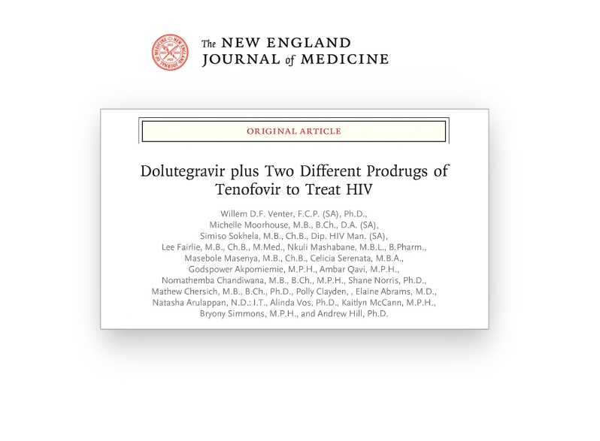
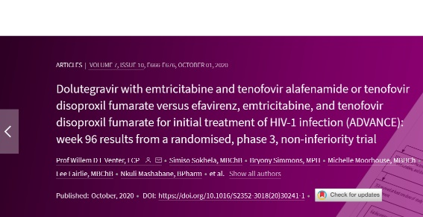
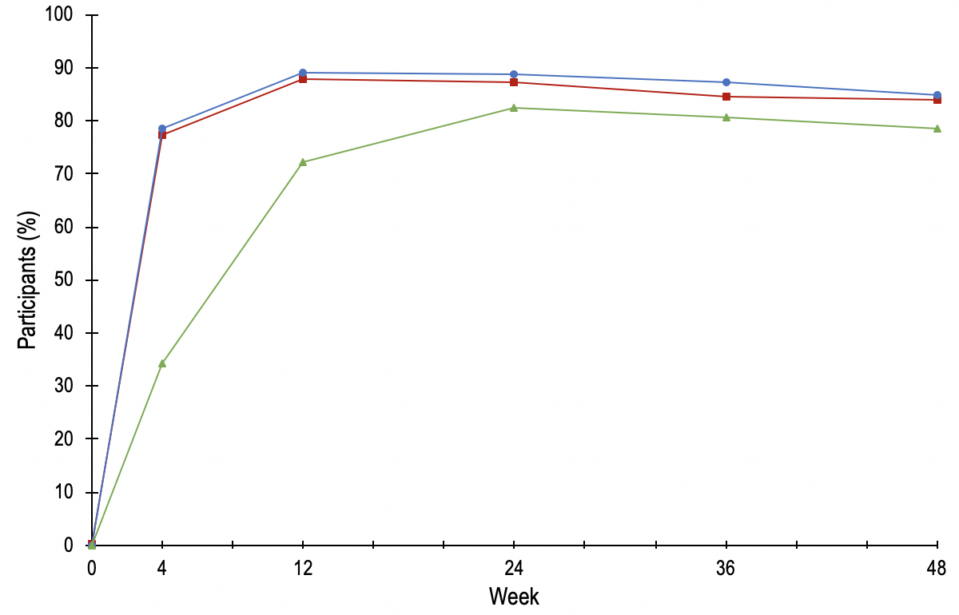

ADVANCE: Study design
Inclusion criteria: treatment-naïve, HIV-1 RNA level ≥ 500 copies/mL, no TB or pregnancy, no baseline genotyping
TAF/FTC+DTG
N=351
1053 Participants
TDF/FTC+DTG
N=351
TDF/FTC/EFV
N=351
96 weeks
Open-label, 96-week study in Johannesburg, South Africa
Study visits at Baseline, Week 4, 12, 24, 36, 48, 60, 72, 84, 96, 144, 192
DTG/TDF/FTC, 84.9%
DTG/TAF/FTC, 83.8%
EFV/TDF/FTC, 78.6%
Notes:
ADVANCE is an ongoing 96-week study being conducted in inner city Johannesburg in South Africa. ADVANCE recruited 1053 ARV-naïve PLWH from age 12 with VL > 500 copies/mL. Randomised to the three regimens described and shown here (TAF/FTC+DTG, TDF/FTC+DTG or standard of care TDF/FTC/EFV). Primary efficacy endpoint was at week 48 and was published in NEJM in July 2019. Study visits occurred at weeks 0, 4, 12, 12 weekly until 96 weeks. DXA scans at weeks 0, 48 and 96

Slide 7
WHO 2019 guidelines: Dolutegravir
Population | First-line regimens | Second-line regimens | Third-line regimens
Adults and adolescents (incl. women of childbearing potential and pregnant women) | Two NRTIs + DTG | Two NRTIs + (ATV/r or LPV/r) | DRV/r + DTG + 1–2 NRTIs (if possible, consider optimisation using genotyping)
 | Two NRTIs + EFV | Two NRTIs + DTG
Children (0–10 years) | Two NRTIs + DTG | Two NRTIs + (ATV/r or LPV/r)
 | Two NRTIs + LPV/r | Two NRTIs + DTG
 | Two NRTIs + NNRTI | Two NRTIs + DTG
Guidelines include recommendations on the selection of ARV drugs in response to high levels of DR¹
  Recommend countries consider changing their first-line ART regimens away from NNRTIs if levels of NNRTI DR reach 10%
1. http://www.who.int/hiv/pub/arv/arv-2016/en/World Health Organization. HIV treatment interim guidance. Accessed August 2018

Slide 8
How has it panned out?
Dolutegravir replaced efavirenz
  Better side effects
    Neural tube defect signal resolved
    Diabetes - speculative
    Weight gain – see next bit, but not dolutegravir
  Better persistence
    Definitely the case –PEPFAR, other cohorts
  Remarkable resistance profile
    Still awaiting any meaningful resistance – years and tens of millions of patients in
  Cheaper
    Price of annual treatment dropped from $110 to $75/year
Dolutegravir has been a massive public health success!
Except in the private sector
Drug

Slide 9
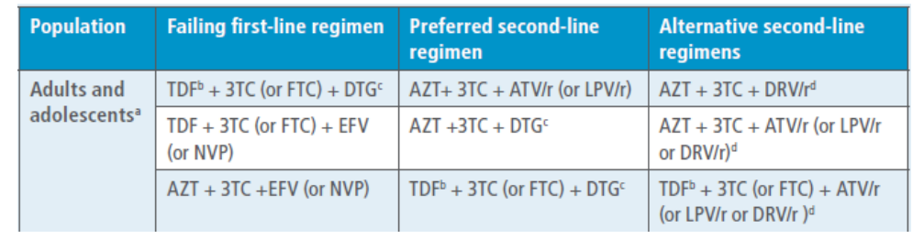
WHO 2021 guidelines: Can we tinker?
Consolidated guidelines on HIV prevention, testing, treatment, service delivery and monitoring: recommendations for a public health approach. Geneva: World Health Organization; 2021. Licence: CC BY-NC-SA 3.0 IGO

Slide 10
Going to take a LOT to displace “TLD” – works great! But option 1…. TAF
Tenofovir disoproxil fumarate
3TC
Dolutegravir
X
Tenofovir alafenamide

Slide 11
TDF vs TAF?
Favours TDF
  More pregnancy data
  Less weight gain
  More safety data, more data from Africa
Favours TAF
  Less impact on kidneys, bone if boosted
  May be cheaper
  Less packaging, smaller tablet, less pharmaceutical

Slide 12
Going to take a LOT to displace “TLD” – works great! But option 2…. Dump TDF altogether
Tenofovir disoproxil fumarate
3TC
Dolutegravir
X

Slide 13
Dual therapy – ‘heresy’
3TC
Dolutegravir
Clear data it works – even for initiation (dolutegravir is THAT powerful)
Obvious cost benefits, but..
Concerns:
  Lose ‘free’ hepatitis B cover (note this will be an issue more and more)
  Will it be durable in Africa?

Slide 14
Going to take a LOT to displace “TLD” – works great! Option 3…. Replace dolutegravir
3TC
?
Tenofovir disoproxil fumarate
Dolutegravir
Why would you want to?
Candidates:
  Bictegravir – carbon-copy with less pregnancy data
  Doravirine – excellent non-nucleoside reverse transcriptase inhibitor, limited pregnancy data, any benefits over dolutegravir?

Slide 15
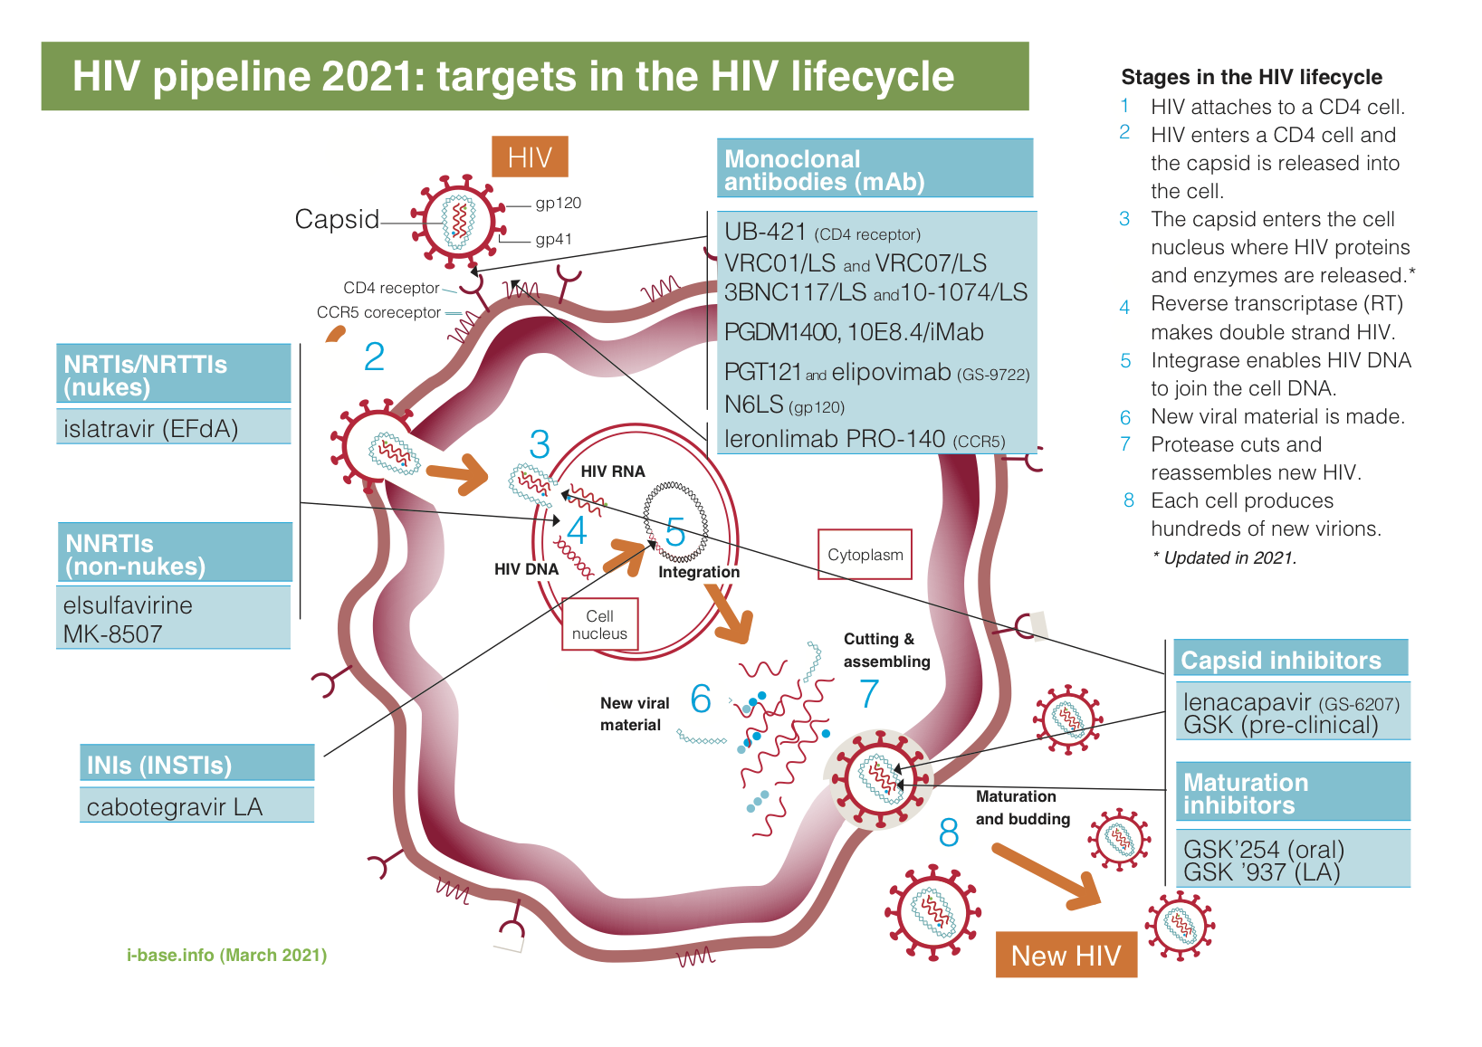
Enough with the tinkering!
The great leap forward is – long actings!

Slide 16
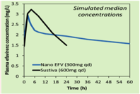


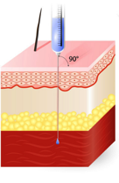
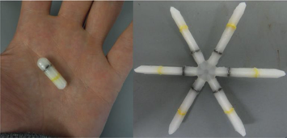
Some concepts
‘Long acting’ – loose term for anything lasting a week or more
Can be oral, injectable (intramuscular or subcutaneous), or implantable
Epidermis
Dermis
Hypodermis
Muscle

Slide 17

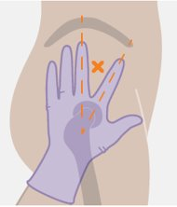
What are we talking practically?
Only 2 formulations registered by FDA
Cabotegravir with rilpivirine for treatment – 2 separate (painful, different sites, cold chain, by trained health workers, expensive) intramuscular injections
Lenacapavir subcutaneous 6-monthly for treatment – but WITH daily tablets in highly experienced patients
Studies with lenacapavir – but battling to find a partner drug!
Islatravir weekly tablet for treatment (monthly dropped) paired with daily tablet, including lenacapavir
Many, many other compounds – none near completion, so at least 2-3 years before registration

Slide 18
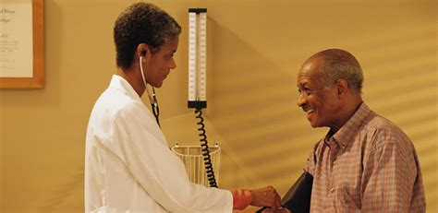
So why all this excitement?
People with HIV love this! Despite pain. And includes men.
Imagine giving a patient 28 tablets for 6 months? Or 6 tablets! Or one injection! Or an implant for a year!
Showing success in drug-using populations
Operational questions – will they ‘love’ coming more often?

Slide 19

Big thorns
Usual intellectual property issues – cabotegravir and ViiV, lenacapavir and Gilead, rilpivirine and J&J
Cost issues being sorted out – modelling, MPP, advocacy, generics, tenders, PEPFAR
Women still deprioritised in research (luckily, PrEP studies giving us pregnancy data) – so some drugs will lack safety data
Long tails – integrase resistance and cabotegravir – studies addressing this

Slide 20

But the biggest challenges are systemic
Health system that does not like complexity
  What if injections are complex?
  Tolerance for more than one regimen is low
BUT important – we have time! We can test with cabotegravir PrEP
  We must learn, and we must learn fast

Slide 21

Getting old (and large) with HIV
“…life expectancy was only a few years lower than that in the general population …. However, for people with low CD4 counts at the start of follow-up, life-expectancy estimates were substantially lower….”
People with HIV fall out of and re-enter the (unfriendly) system
They get chronic diseases – like we all do
They gain weight – like we all do (except more)

Slide 22



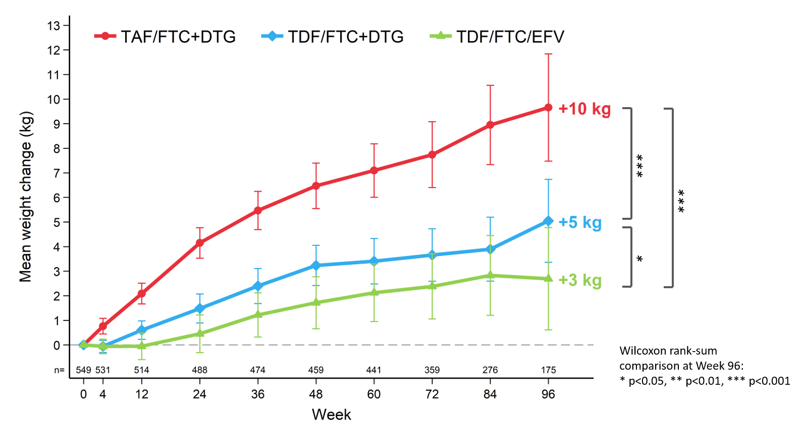

One patient on ADVANCE, BMI>60: “I have done everything you told me, please help me”.

Slide 23


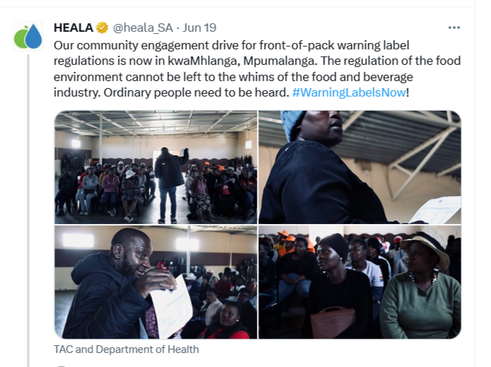
Weight gain and obesity
Traditional medical advice: “move more and eat less” – which do not work for weight loss by themselves
New medications (and old medications) – 15-20% weight loss routinely after 14-15 months
But need to address food industry
Civil society alliances forcing government to action

Slide 24
Getting old (and large) with HIV
People with HIV fall out of and re-enter the (unfriendly) system
They get chronic diseases – like we all do
They gain weight – like we all do (except more)
Social determinants, issues like mental health, become more and more important

Slide 25

Finally
New drugs are exciting but are not going to fix systems
Long-acting formulations will stress inflexible primary care
Need a plan for weight gain
Need creativity and activism for integration, better systems

Slide 26


