Slide 1

The use of bedaquiline in south africa
Prof. Norbert NDJEKA
MD, DHSM (Wits), MMed (Fam Med) (MED), Dip HIV Man (CMSA), DSc (h.c.) (UCT)
Chief Director: TB Control & Management
September 14th, 2023

Slide 2

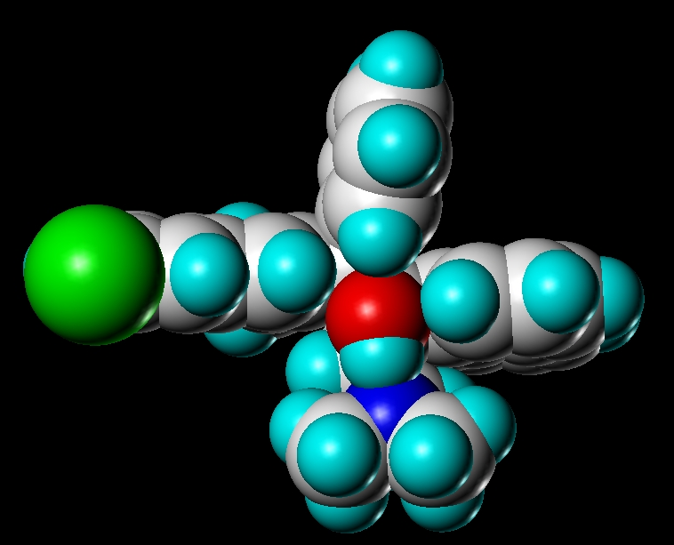
BDQ Antibacterial Spectrum
Non-mycobacteria:
Mycobacteria:
MIC ≥4 μg/mL
H. pylori
Str. pyogenes
St. aureus
S. typhimurium
S. pneumoniae
E. coli
E. faecalis
E. faecium
P. aeruginosa
H. influenzae
MIC ≤0.063 μg/mL
M. tuberculosis
DS-TB, MDR-TB
21 other species
MIC 0.12-0.50 μg/mL
3 other species
MIC 4-8 μg/mL
3 other species
R207910
TMC207
bedaquiline
Andries et al, Science 2005, 307, 223

Slide 3

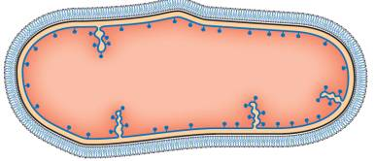
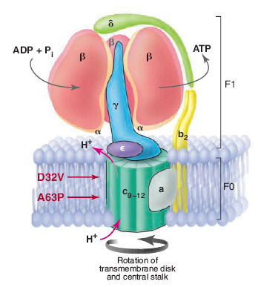
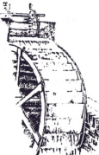
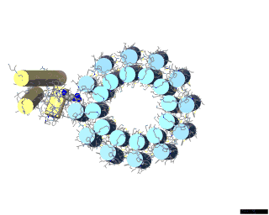
Mechanism of Action
In strains resistant to bedaquiline, mutations were identified in the gene coding for ATP synthase
Provides energy (ATP) from a trans-membrane proton gradient
Adapted from Science 2005, 307, 214

Slide 4

EVIDENCE BASED PRACTICE

Slide 5
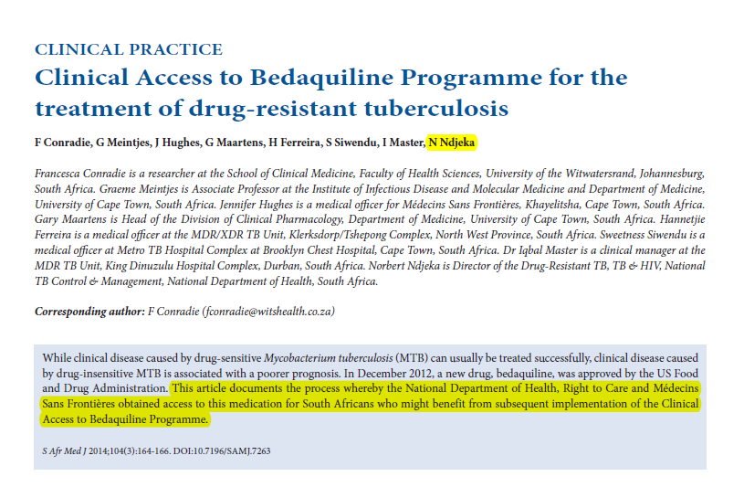
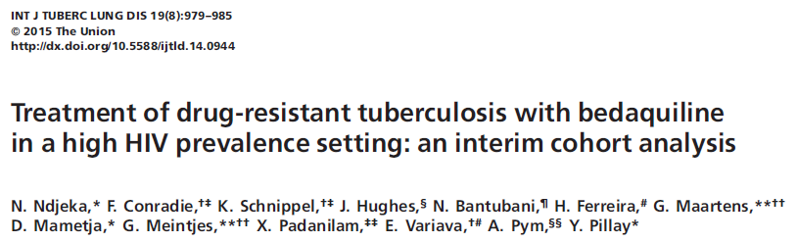
SOUTH AFRICAN IMPLEMENTATION PATHWAY FOR BDQ
Diacon AH. et al, N Engl J Med. 2014;371:723–32; Pym AS et al. Eur Respir J. 2016;47:564–7; Conradie, F et al, SAMJ; Ndjeka N et al, Eur Resp J 2018;52: pii: 1801528; Ndjeka N et al, Int J Tuberc Lung Dis 2015;19:979-85.Schnippel K et al. Lancet Respir Med. 2018;6:699–706; Brigden G, et al. PLoS Med. 2019;16:e1002896.
c

Slide 7
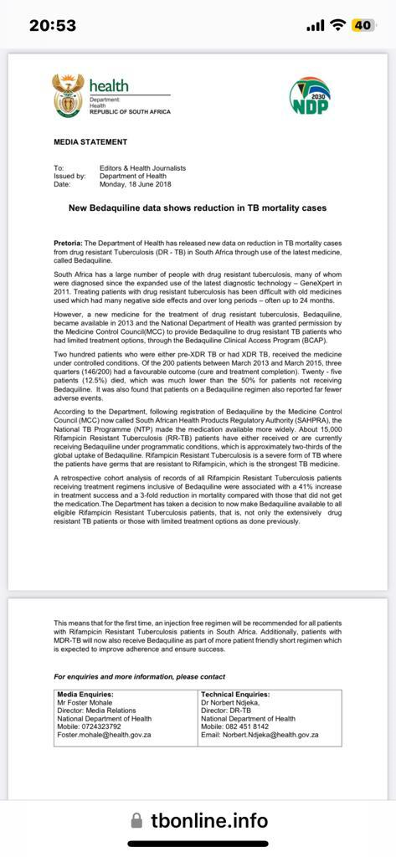

Slide 8
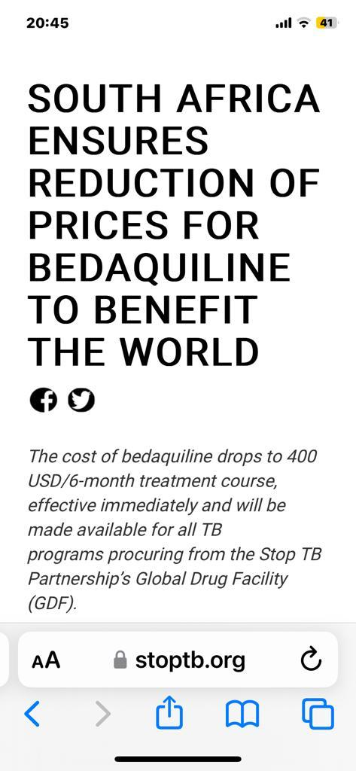
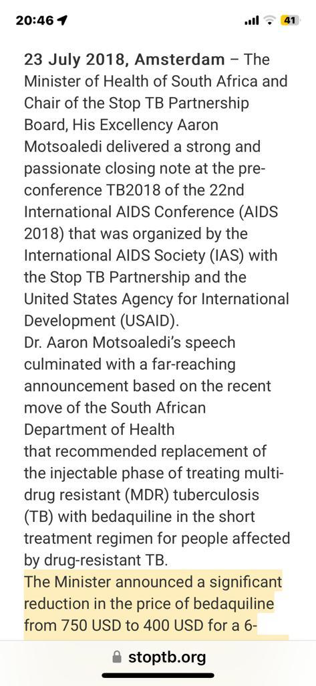
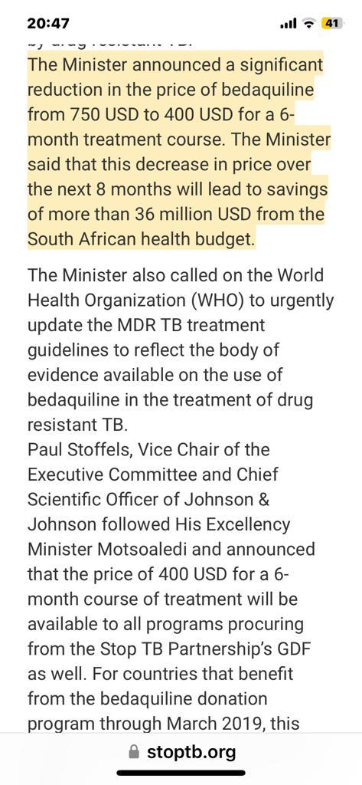

Slide 9
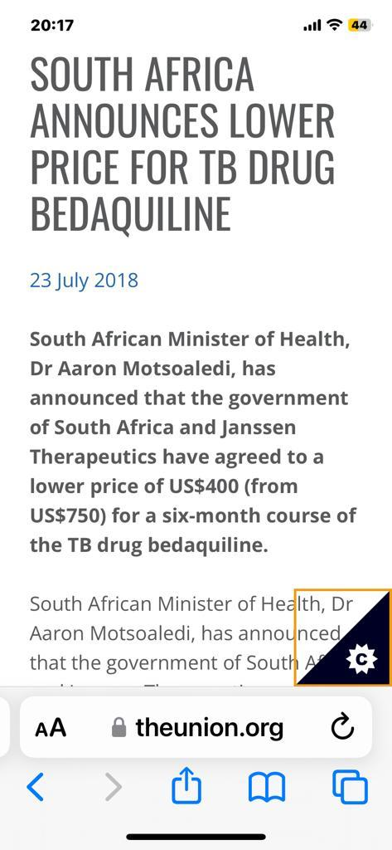
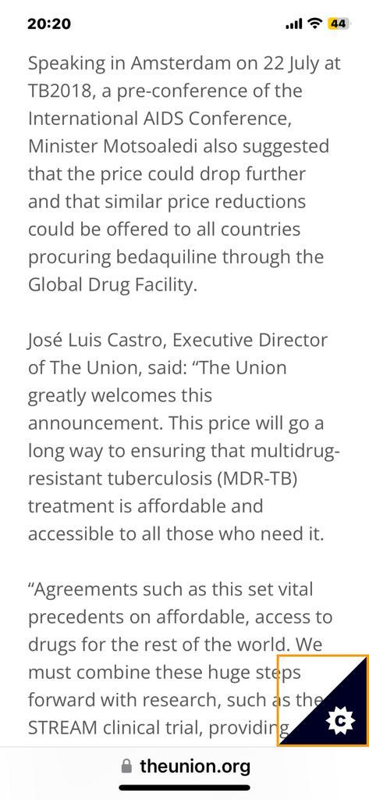

Slide 10
Stop TB’s Global Drug Facility Announces Historic Price Reductions up to 55% for
Bedaquiline, a Life-Saving Drug to Treat Drug-Resistant TB
Treatment regimens for drug resistant TB will see a price drop up to 29%
Embargoed until 10:00 EST / 16:00 CEST on Wednesday 30th August
GENEVA, 30 August, 2023: The Stop TB Partnership’s Global Drug Facility (GDF) today announced
price reductions up to 55% for bedaquiline, a critical drug used to treat drug-resistant TB (DR-TB).
The new, reduced bedaquiline prices - secured through an open, competitive tender and valid through December 2024 - are as follows:
Johnson & Johnson: US$130 per 6-month treatment course
Lupin: US$194 per 6-month treatment course

Slide 12
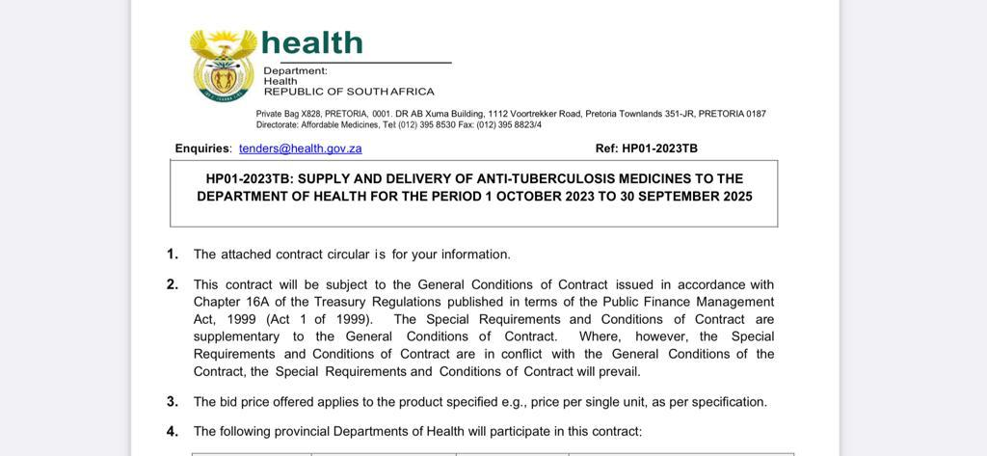

Slide 13
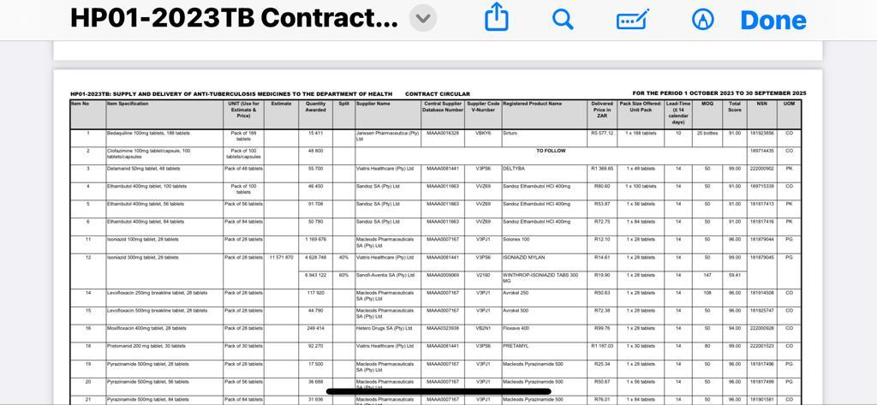

Slide 14
Conclusion
Bedaquiline GDF price reduction was negotiated by Dr Aaron Motswaledi
The initial price was $ USD 750
It was reduced to $ USD 400 in July 2028
This was R 5,400 in RSA
Prior to that the price was R 9,900
Despite the R/$ exchange variation the price remained the same in Rands
Recently the price increased to R 5,500 with effect from October 1st, 2023
The Affordable Medicines Cluster is working on this matter as well as the Competition Commission

Slide 15
Thank you

